Slide 1

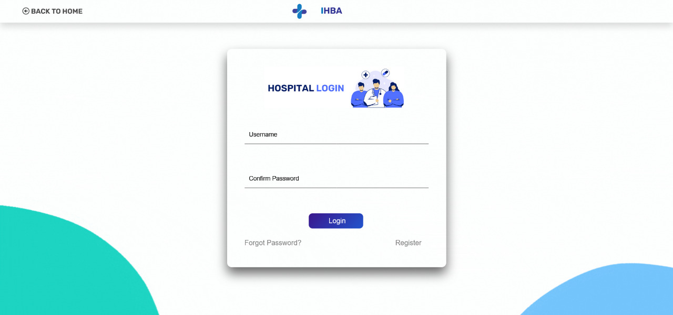
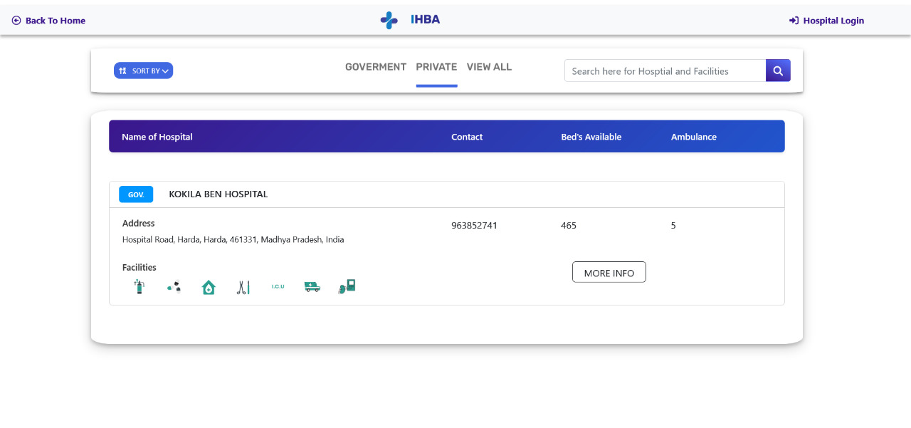
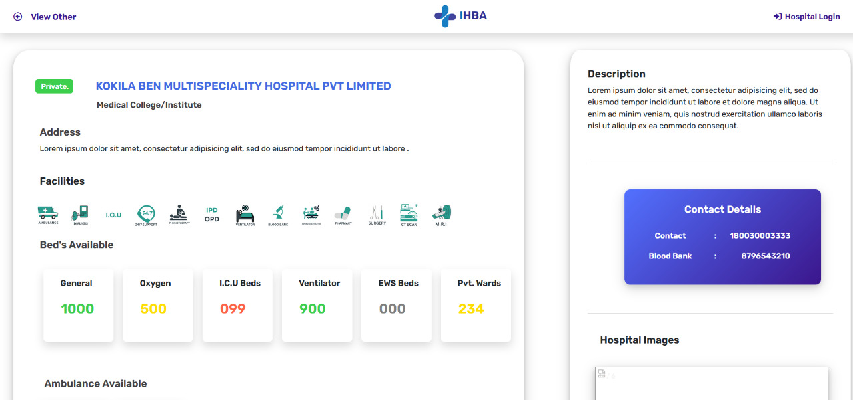
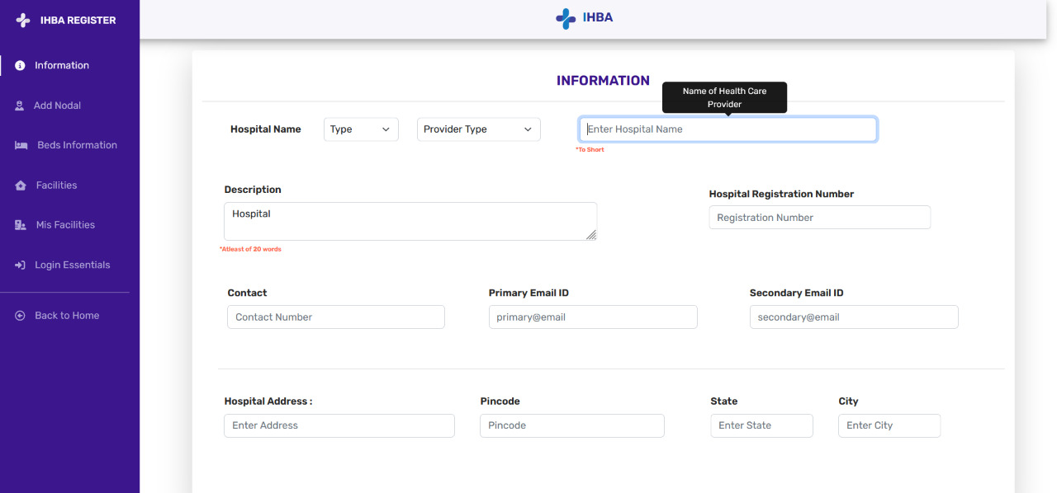
Hospital Equipment Availability Checking Website
Ansh Joshi, Bhavik Mundra, Bhavik Sharma, Bhavika Darpe
Acropolis Institute of Technology & Research
INTRODUCTION
FEATURES
TECHNOLOGY USED
CONCLUSION
The world is becoming more advanced nowadays. Everything that is manual is being transferred digitally for faster speed and better work in every aspect, like education, business, government work, hospitals. Whenever you visit a hospital in a case of emergency or any health-related problem, it seems that you don't get beds on time, the facilities and equipment are not available, and you were not aware of these things previously just because there is no facility that provides you information regarding whether the hospital is available or not. Many patients suffer because of this situation, and so many die also, just because the ICU beds in the hospitals are occupied and they have to wait in the general ward for their turn, and due to the delay in time, many people lose their lives. The project uses Python, Flask, SQLAlchemy, HTML, CSS, and JavaScript to create this website successfully. We take data from hospitals by providing a registration form which will be fielded by the hospital management department. The data is going to be stored in a database, and then we provide information to users as per their requirements.
FLASK: Flask is a micro web framework written in Python. It is classified as a microframework because it does not require particular tools or libraries. It has no database abstraction layer, form validation, or any other components.
Flask MAIL: The Flask-Mail extension provides a simple interface to set up SMTP with your Flask application and to send messages from your views and scripts.
Flask SQLAlchemy: Flask-SQLAlchemy is an extension for Flask that adds support for SQLAlchemy to your application. It simplifies using SQLAlchemy with Flask by setting up common objects and patterns for using those objects.
PYTHON: Python is a high-level, general-purpose programming language.
HTML 5: HTML 5 is a markup language used for structuring and presenting content on the World Wide Web.
CSS 3: CSS describes how elements should be rendered on screen, on paper, in speech, or on other media.
JavaScript: It often abbreviated as JS, is a programming language that is one of the core technologies of the World Wide Web, alongside HTML and CSS. JS is used to program the behaviour of web pages. JS libraries and frameworks make website and application development easier with wide-ranging features and functionalities.
Bootstrap: Bootstrap is a free and open-source CSS framework directed at responsive, mobile-first front-end web development.
The computerised system provides an efficient way to avail the facilities without consuming much time. It is easy for the users to keep track of empty beds as information will always remain updated.
Bridge between hospitals and patients
FUTURE SCOPE
This project is intended to serve user with the recommendation system to recommend best hospital based on some question and their actions on our portal. Also all updates are shared via notification and mail. Booking of hospital can also be checked via this web application.
User friendly environment:
REFERENCES
https://flask.palletsprojects.com/en/2.2.x/
https://getbootstrap.com/
OBJECTIVES
The main objective of this project is to get the information about the availability of different types of beds in the hospitals of Indore.
Additionally, this product provides information about the facilities provided by the hospital.
The aim of this web application is to treat needs of hospitalized patients whose needs could be met outside a traditional hospital setting.
Timely updated authorized information available:
CONTACT
Ansh Joshi
anshshailesh20033@acropolis.in
Bhavik Mundra
bhavikmundra20137@acropolis.in
Bhavik Sharma
bhaviksharma20111@acropolis.in
Bhavika Darpe
bhavikadarpe20025@acropolis.in
Easy access to all hospital

